Slide 1
Recurrence Relation
Unit-3
Divide and Conquer Algorithm

Slide 2
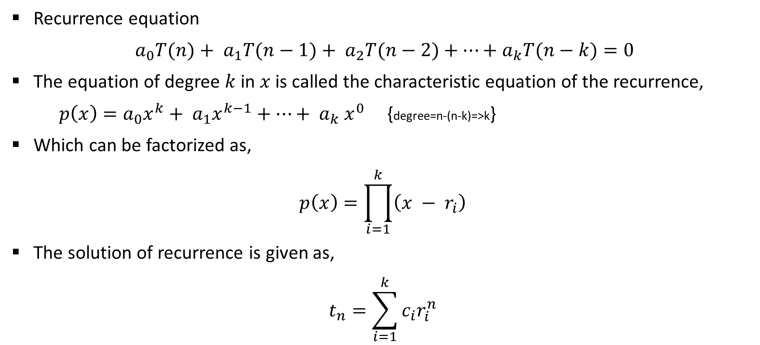
Homogeneous Recurrence
Recurrence equation
$a_{0}T(n)+ a_{1}T(n−1)+ a_{2}T(n−2)+⋯+a_{k}T(n−k)=0$
The equation of degree $k$in $x$ is called the characteristic equation of the recurrence,
$p\left(x\right)=a_{0}x^{k}+ a_{1}x^{k−1}+⋯+ a_{k} x^{0}$ {degree=n-(n-k)=>k}
Which can be factorized as,
$$p\left(x\right)=\prod_{i=1}^{k}{\left(x − r_{i}\right)}$$
The solution of recurrence is given as,
$$t_{n}=\sum_{i=1}^{k}{c_{i}r_{i}^{n}}$$

Slide 3
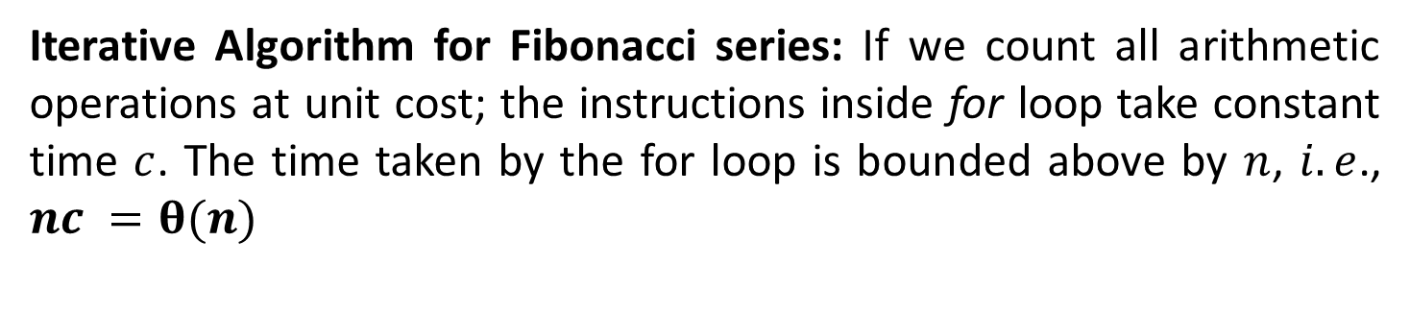
Analysis: Fibonacci series
Function fibiter(n)
i ← 1; j ← 0;
for k ← 1 to n do
j ← i + j;
i ← j – i;
return j
Iterative Algorithm for Fibonacci series: If we count all arithmetic operations at unit cost; the instructions inside for loop take constant time $c$. The time taken by the for loop is bounded above by $n$, $i.e$., $nc =θ(n)$

Slide 4
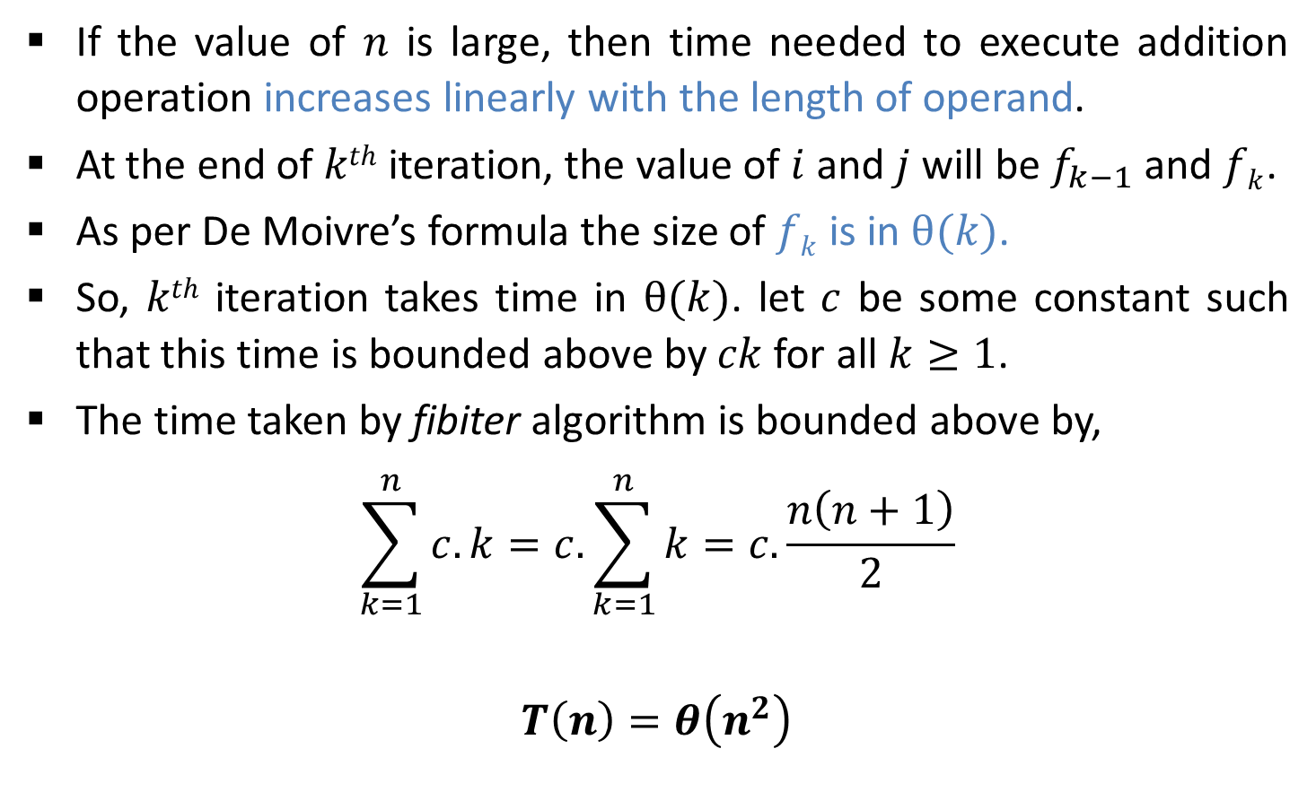
Analysis: Fibonacci series
If the value of $n$ is large, then time needed to execute addition operation increases linearly with the length of operand.
At the end of $kth$ iteration, the value of $i$ and $j$ will be $f_{k−1}$ and $fk$.
As per De Moivre’s formula the size of $fk$is in $θ(k)$.
So, $kth$ iteration takes time in $θ(k)$. let $c$ be some constant such that this time is bounded above by $ck$for all $k≥1$.
The time taken by fibiter algorithm is bounded above by,
$$\sum_{k=1}^{n}{c.k=c.\sum_{k=1}^{n}{k}}=c.\frac{n\left(n+1\right)}{2}$$
$$T\left(n\right)=θ\left(n^{2}\right)$$

Slide 5

Analysis: Fibonacci series
Recursive Algorithm for Fibonacci series,
The recurrence equation of above algorithm is given as,
$$T(n)=\left\{\begin{aligned}Const (1/2) if n=0 or 1 \\ T\left(n−1\right)+T \left(n−2\right) o/w\end{aligned}\right.$$
The recurrence can be re-written as,
$$T\left(n\right)−T\left(n−1\right)−T\left(n−2\right)=0$$
Function fibrec(n)
if n < 2 then return n
else return fibrec (n – 1) + fibrec (n – 2)

Slide 6

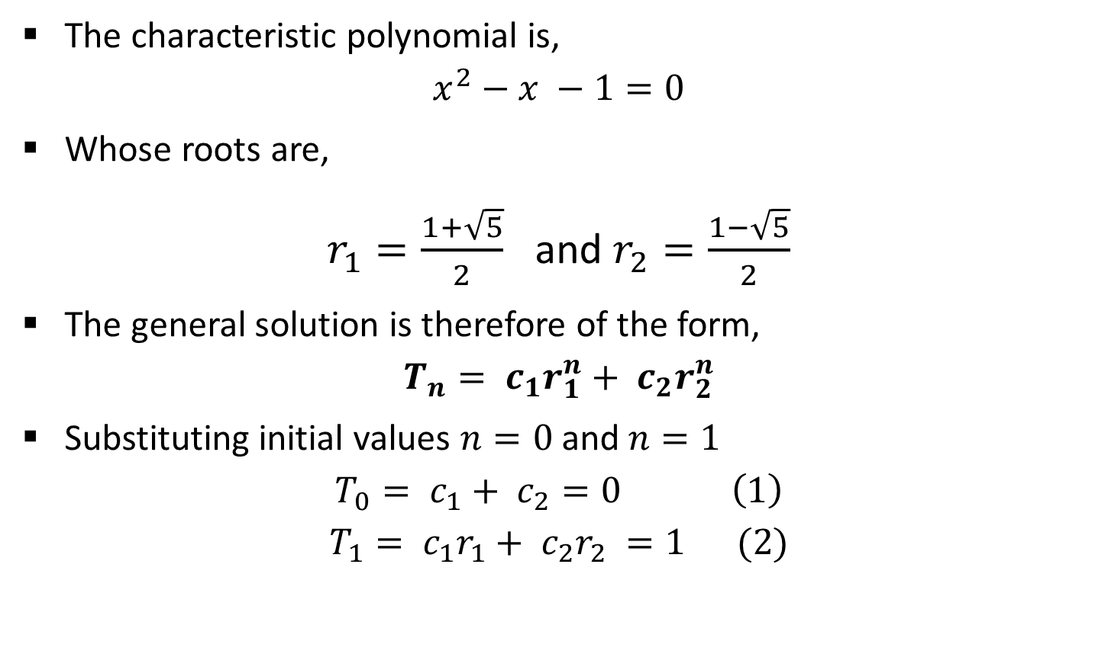

Analysis: Fibonacci series
The characteristic polynomial is,
$$x^{2}−x −1=0$$
Whose roots are,
$r_{1}=\frac{1+\sqrt{5}}{2}$ and $r_{2}=\frac{1−\sqrt{5}}{2}$
The general solution is therefore of the form,
$$T_{n}= c_{1}r_{1}^{n}+ c_{2}r_{2}^{n}$$
Substituting initial values $n=0$and $n=1$
$$T_{0}= c_{1}+ c_{2}=0 \left(1\right)$$
$$T_{1}= c_{1}r_{1}+ c_{2}r_{2} =1 (2)$$
$$x =\frac{−b±\sqrt{b^{2}−4ac}}{2a}$$
$$t_{n}=\sum_{i=1}^{k}{c_{i}r_{i}^{n}}$$

Slide 7
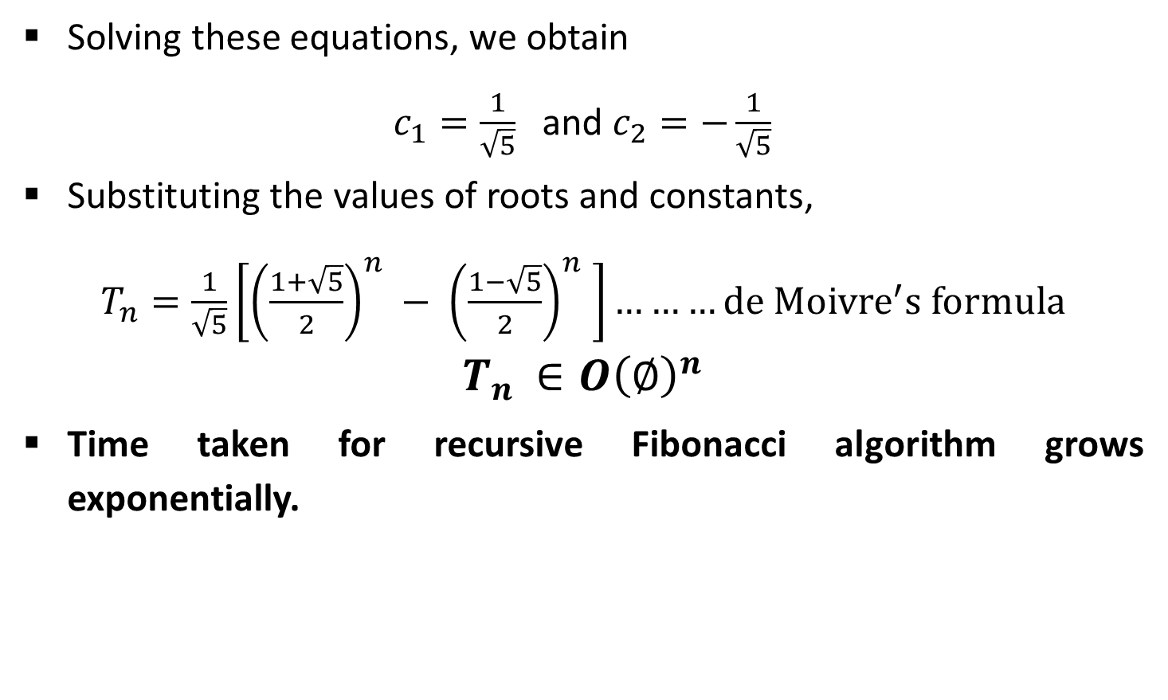
Analysis: Fibonacci series
Solving these equations, we obtain
$c_{1}=\frac{1}{\sqrt{5}}$ and $c_{2}=−\frac{1}{\sqrt{5}}$
Substituting the values of roots and constants,
$T_{n}=\frac{1}{\sqrt{5}}\left[{\left(\frac{1+\sqrt{5}}{2}\right)}^{n} − {\left(\frac{1−\sqrt{5}}{2}\right)}^{n} \right]………de {Moivre}^{′}s formula$
$$T_{n }∈O{\left(∅\right)}^{n}$$
Time taken for recursive Fibonacci algorithm grows exponentially.

Slide 8
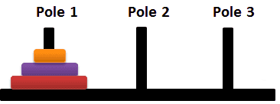



Analysis: Tower of Hanoi

Slide 9



Analysis: Tower of Hanoi

Slide 10
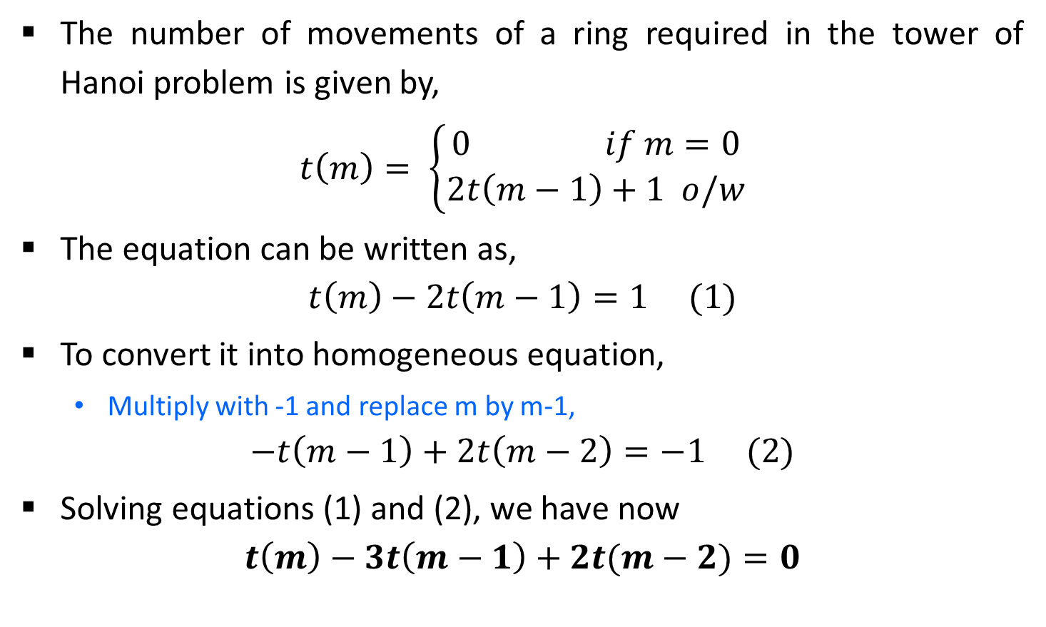
Analysis: Tower of Hanoi
The number of movements of a ring required in the tower of Hanoi problem is given by,
$$t\left(m\right)= \left\{\begin{aligned}0 if m=0 \\ 2t\left(m−1\right)+1 o/w\end{aligned}\right.$$
The equation can be written as,
$$t\left(m\right)−2t\left(m−1\right)=1 (1)$$
To convert it into homogeneous equation,
Multiply with -1 and replace m by m-1,
$$−t\left(m−1\right)+2t\left(m−2\right)=−1 (2)$$
Solving equations (1) and (2), we have now
$$t\left(m\right)−3t\left(m−1\right)+2t(m−2)=0$$
Inhomogeneous equation

Slide 11
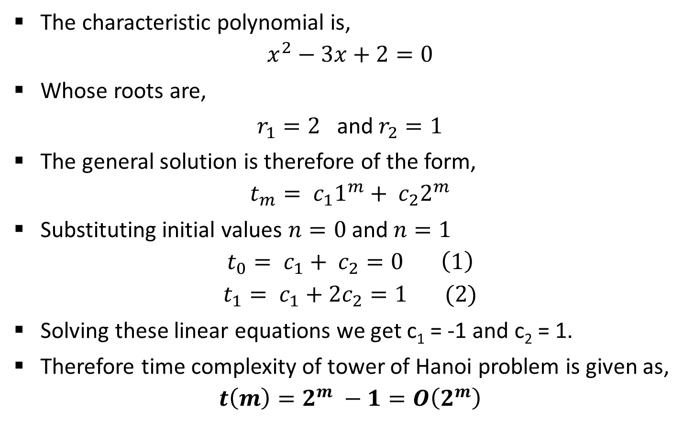
Analysis: Tower of Hanoi
The characteristic polynomial is,
$$x^{2}−3x+2=0$$
Whose roots are,
$r_{1}=2$ and $r_{2}=1$
The general solution is therefore of the form,
$$t_{m}= c_{1}1^{m}+ c_{2}2^{m}$$
Substituting initial values $n=0$and $n=1$
$$t_{0}= c_{1}+ c_{2}=0 \left(1\right)$$
$$t_{1}= c_{1}+2c_{2}=1 (2)$$
Solving these linear equations we get c₁ = -1 and c₂ = 1.
Therefore time complexity of tower of Hanoi problem is given as,
$$t\left(m\right)=2^{m} −1=O\left(2^{m}\right)$$

Slide 12
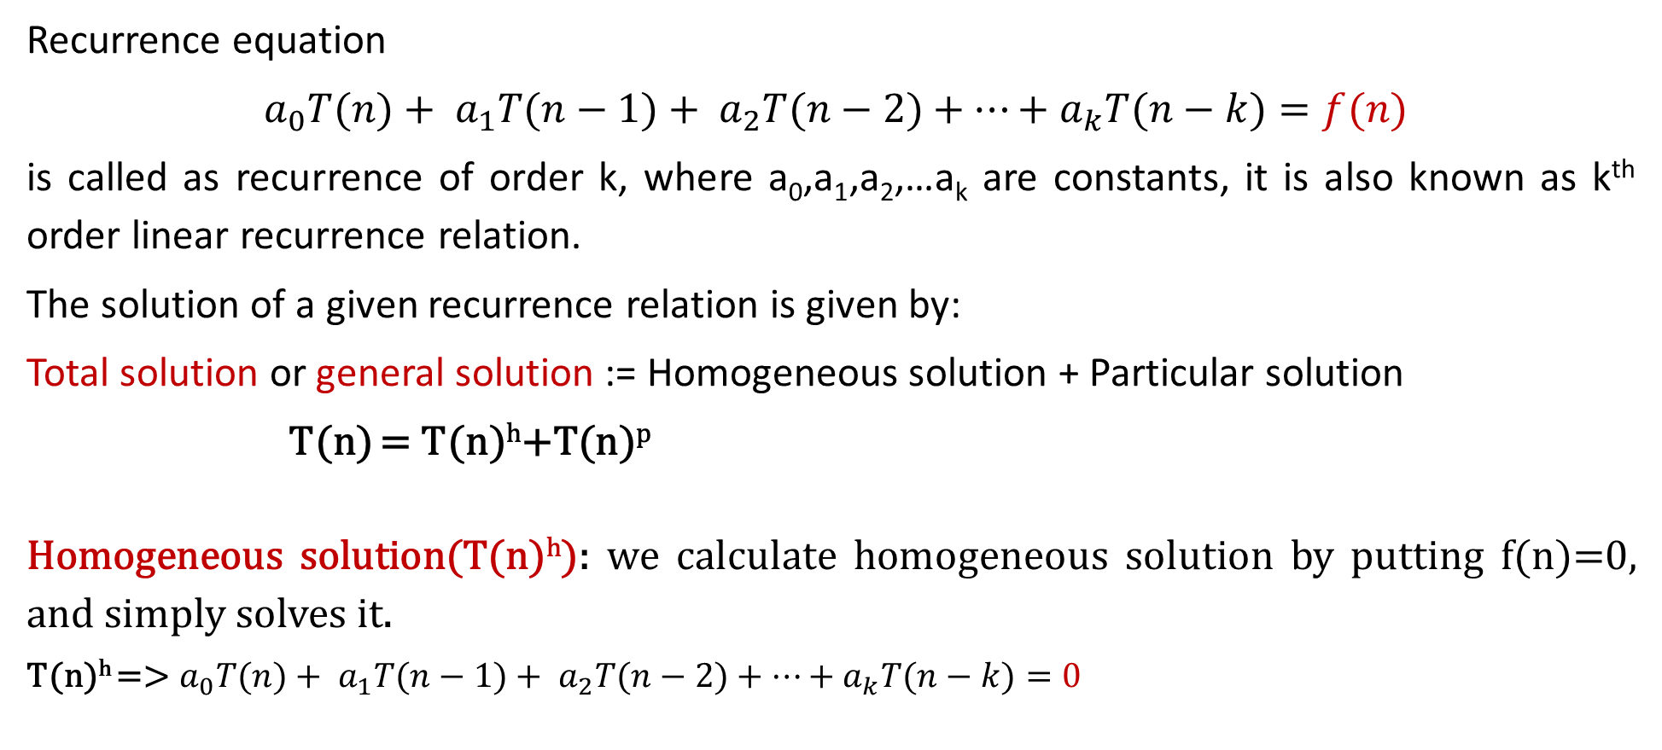
Non-homogeneous recurrence
Recurrence equation
$a_{0}T(n)+ a_{1}T(n−1)+ a_{2}T(n−2)+⋯+a_{k}T(n−k)=f(n)$
is called as recurrence of order k, where a₀,a₁,a₂,…a_{k} are constants, it is also known as k^{th} order linear recurrence relation.
The solution of a given recurrence relation is given by:
Total solution or general solution := Homogeneous solution + Particular solution
T(n) = T(n)^{h}+T(n)^{p}
Homogeneous solution(T(n)^{h}): we calculate homogeneous solution by putting f(n)=0, and simply solves it.
T(n)^{h} =>${ a}_{0}T(n)+ a_{1}T(n−1)+ a_{2}T(n−2)+⋯+a_{k}T(n−k)=0$

Slide 13
Particular solution(T(n)^{p}): it exist only when RHS of recurrence relation is non-zero. i.e. f(n)≠0.
If f(n)≠0 we consider three possibility:
Case1: f(n) is constant
Case2: f(n) is polynomial of degree n
Case3: f(n) is exponential

Slide 14
Particular solution(T(n)^{p})
Case1: f(n) is constant
find p by putting T(n)=p,
If fails, put T(n)=np
If fails, put T(n)=n²p…
T(n)-2T(n-1)+T(n-2)=1
=> To calculate Particular solution
=> put T(n)=P
=> P-2(P-1)+P-2=1
=> 0=1 fail
=> put T(n)=nP
=> nP-2(n-1)P+(n-2)P=1
=> 0=1 fail
=> put T(n)=n²P
=> n²P – 2(n-1)²P+(n-2)P=1
=> p=1/2
=> Now put the value of P in solution
T(n)^{p}=n²P=>n²/2

Slide 15
Particular solution(T(n)^{p})
Case2: f(n) is polynomial
T(n)=d₀+d₁n+d₂n²…d_{m}n^{m}
Find d0, d1, d2.. Y comparing the co-efficient
T(n)-8T(n-1) =14n+5
=> To calculate Particular solution
=> put T(n)= d₀+d₁n
=> d₀+d₁n – 8(d₀+d₁(n-1))=14n+5
=> -7d₀ – 7d₁n+8d₁=5 + 14n
=> By comparing the coefficient of n⁰, n¹ term
=> -7d₁=14 => d₁=-2
=> -7d₀+8d₁=5 =>d₀= -3
Now put the value of d₀ and d₁ to get the solution
T(n)^{p}=d₀+d₁n
T(n)^{p}= -3 + (-2)n

Slide 16
Particular solution(T(n)^{p})
Case3: f(n) is exponential function find d by putting T(n)=d*a^{n},
if homogeneous solution contains a term single a^{k} then T(n)= n(d*a^{n})
if contain two times then
T(n)= n²(d*a^{n})
T(n)-8T(n-1) =5 * 2^{n}
=> To calculate Particular solution
=> put T(n)= da^{n {a=2}}
=> d*2^{n} – 8*d2^{n-1}=5*2^{n}
=> d*2^{n} – 4*2¹*d2^{n-1}=5*2^{n}
=> d*2^{n} – 4*d2^{n}=5*2^{n}
=>2^{n}(d-4d)=5*2^{n}
=> By comparing the coefficient of 2^{n}
=> d=-5/3
Now put the value of d to get the solution
T(n)^{p}=da^{n}
T(n)^{p}= -3/2 * 2^{n}

Slide 17
Find the total solution: T(n)-8T(n-1) =14n+5
1. Homogeneous solution(T(n)^{h})
T(n)-8T(n-1)=0
characteristic equation
X-8=0 , roots=(8)
T(n)^{h} = c₁8^{n}
2. Particular solution(T(n)^{p})
=> put T(n)= d₀+d₁n
=> d₀+d₁n – 8(d₀+d₁(n-1))=14n+5
=> -7d₀ – 7d₁n+8d₁=5 + 14n
=> By comparing the coefficient of n⁰, n¹ term
=> -7d₁=14 => d₁=-2
=> -7d₀+8d₁=5 =>d₀= -3
Now put the value of d₀ and d₁ to get the solution
T(n)^{p}=d₀+d₁n
T(n)^{p}= -3 + (-2)n
Total solution(T(n))=(T(n)^{h}) + (T(n)^{h})
T(n) = c₁8^{n} -3 + (-2)^{n}

